Slide 1
Software Architecture
Grady Booch
IBM Fellow

Slide 2
The role of software
Our civilization runs on software
  Innovation to capture new value
  Improving productivity of resources deployed
The privilege and responsibility of the software professional

Slide 3
How much software exists in the world?
SLOC is a measure of labor (not of value)
  Old code never dies (you have to kill it)
  Some code is DOA
Some assumptions
  1 SLOC = 1 semicolon
  Number of software professionals worldwide
  %of software professionals who cut code
  SLOC/developer/year
  $100US/SLOC

Slide 4
Number of software professional worldwide

Slide 5
% of software professionals who cut code

Slide 6
SLOC/developer/year

Slide 7
New or modified SLOC/year and cumulative

Slide 8
Dimensions of software complexity
Walker Royce
Higher technical complexity
- Embedded, real-time, distributed, fault-tolerant
- Custom, unprecedented, architecture reengineering
- High performance
An average software project
- 5-10 people
- 3-9 month duration
- 3-5 external interfaces
- Some unknowns & risks
Telecom
Switch
Defense
Weapon System
Commercial
Compiler
National Air Traffic
Control System
Embedded
Automotive
Software
Lower
management
complexity
- Small scale
- Informal
- Single stakeholder
- “Products”
CASE Tool
Large-Scale
Organization/Entity
Simulation
Higher
management
complexity
- Large scale
- Contractual
- Many stake holders
- “Projects”
Small Scientific
Simulation
IS Application
Distributed Objects
(Order Entry)
Enterprise IS
(Family of IS
Applications)
Defense
MIS System
IS Application
GUI/RDB
(Order Entry)
Business
Spreadsheet
Lower technical complexity
- Mostly 4GL, or component-based
- Application reengineering
- Interactive performance

Slide 9
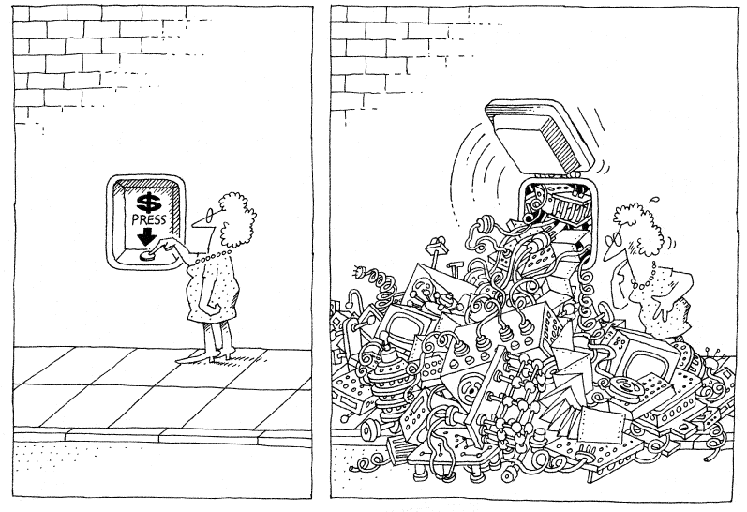
Creating the illusion of simplicity

Slide 10
The entire history of software engineering
Is one of rising levels of abstraction
Languages:
Platforms:
Processes:
Architecture:
Tools:
Enablement:
Assembly -> Fortran/COBOL -> Simula -> C++ -> Java
Naked HW -> BIOS -> OS -> Middleware -> Domain-specific
Waterfall -> Spiral -> Iterative -> Agile
Procedural -> Object Oriented -> Service Oriented
Early tools -> CLE -> IDE -> XDE -> CDE
Individual -> Workgroup -> Organization

Slide 11

Architecting a dog house
Can be built by one person
Requires
Minimal modeling
Simple process
Simple tools

Slide 12
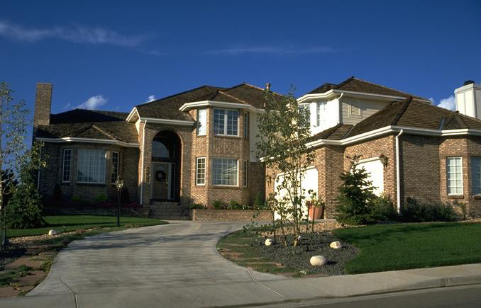
Architecting a house
Built most efficiently and timely by a team
Requires
Modeling
Well-defined process
Power tools

Slide 13
Architecting a high rise

Slide 14
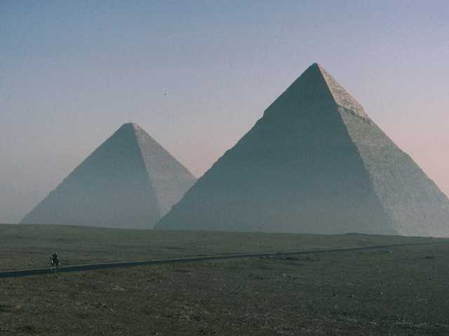
Early architecture
Progress
- Limited knowledge of theory

Slide 15
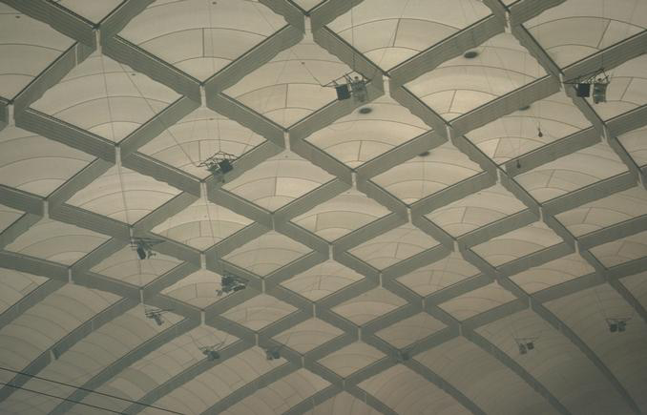
Contemporary architecture
Progress
- Advances in materials
- Advances in analysis
Scale
- 5 times the span of the Pantheon
- 3 times the height of Cheops

Slide 16
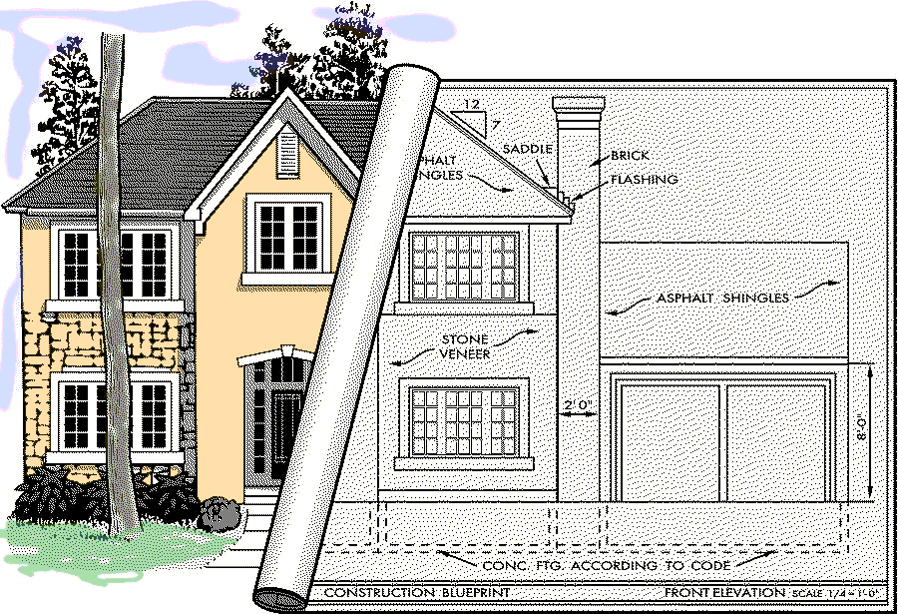
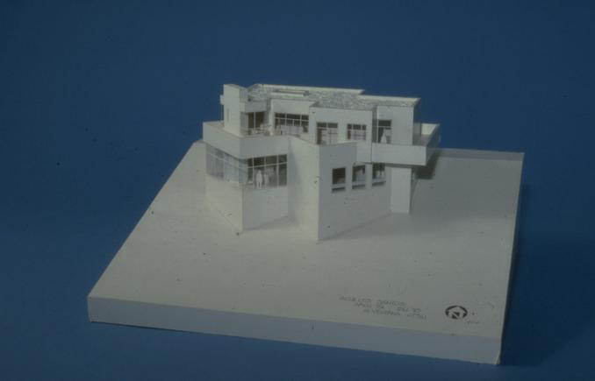
Modeling a house

Slide 17
Movements in civil architecture
Bronze age/Egyptian (Imhotep)
Grecian/Roman (Vitruvius)
Byzantine/Romanesque
Gothic
Mannerism (Michelangelo, Palladio)
Baroque
Engineering/Rational/National/Romantic
Art noveau
Modern movement (Wright, LeCorbusier, Geary, Libeskind)
Progress
- Imitation of previous efforts
- Learning from failure
- Integration of other forces
- Experimentation

Slide 18
Kinds of civil architecture
Community
  houses, flats and apartments, gardens, education, hospitals, religion
Commerce
  shops and stores, restaurants, hotels, office buildings, banks, airports
Industry
  industrial buildings, laboratories, farm buildings
Leisure
  sport, theaters and cinemas, museums
Neufert, Architect’s Data

Slide 19
Mechanisms in mechanical engineering
daVinci
Screws
Keys
Rivets
Bearings
Pins, axles, shafts
Couplings
Ropes, belts, and chains
Friction wheels
Toothed wheels
Flywheels
Levers and connecting rods
Click wheels and gears
Ratchets
Brakes
Pipes
Valves
Springs
Cranks and rods
Cams
Pulleys
Engaging gears
daVinci

Slide 20
Forces in civil architecture
Load
Kinds of loads
- Dead loads
- Live loads
- Dynamic loads
Compression
Tension
Avoiding failure
- Safety factors
- Redundancy
- Equilibrium
Load
Any time you depart from established practice, make ten times the
effort, ten times the investigation. Especially on a very large project.
- LeMessuier

Slide 21
Shearing layers of change
Space plan
Services
Stuff
Structure
Skin
Site
Brand, How Buildings Learn

Slide 22
Everything has an architecture

Slide 23
The economics of software
Performance
= (Complexity) ^{(Process)} * (Team) * (Tools)
Where:
  Performance = Effort or time
  Complexity = Volume of human-generated code
  Process = Methods, notations, maturity
  Team = Skill set, experience, motivation
  Tools = Software process automation
Boehm, Software Engineering Economics

Slide 24
The software development paradox
Building quality software that matters is fundamentally hard
  All interesting software embodies essential complexity
Software-intensive systems
  Can amplify human intelligence, but they cannot replace human judgment
  Fuse, coordinate, classify, and analyze information, but they cannot create knowledge
From vision to execution
  Not everything we want to build can be built
  Not everything we want to build should be built

Slide 25
The limits of technology
Fundamental
The laws of physics
The laws of software
The challenge of algorithms
The difficulty of distribution
The problems of design
The importance of organization
The impact of economics
The influence of politics
The limits of human imagination
Human

Slide 26
Software development
has been, is, and remains hard

Slide 27
Forces In Software
Functionality
Cost/Schedule
Compatibility
Performance
Reliability/Availability
Capacity
Security
Scalability
Fail safe/Fault tolerance
Technology churn
Resilience

Slide 28
Points of friction
Start up
Work product collaboration
Communication
Time starvation
Stakeholder cooperation
Stuff that doesn’t work

Slide 29
Misconceptions about architecture
Architecture is just paper
Architecture and design are the same things
Architecture and infrastructure are the same things
<my favorite technology> is the architecture
A good architecture is the work of a single architect
Architecture is simply structure
Architecture can be represented in a single blueprint
System architecture precedes software architecture
Architecture cannot be measured or validated
Architecture is a science
Architecture is an art
Kruchten

Slide 30
Architecture is just paper
A system’s architecture ultimately resides in executable code
A system’s architecture may be visualized in models
Every system has an architecture; some architectures are made manifest and visible, many others are not

Slide 31
Architecture is design
All architecture is design, but not all design is architecture
Architecture focuses on significant design decisions, decisions that are both structurally and behaviorally important as well as those that have a lasting impact on the performance, reliability, cost, and resilience of the system
Architecture involves the how and the why, not just the what

Slide 32
Architecture is infrastructure
Infrastructure is an integral and important part of architecture, but there is more to architecture than just infrastructure
Significant patterns will manifest themselves at many different levels and dimensions of a system
Too narrow a view of architecture will lead to a very pretty infrastructure, but the wrong infrastructure for the problem at hand

Slide 33
<my favorite technology> is the architecture
A given technology only serves to implement some dimension of an architecture
  The network is the architecture
  The database is the architecture
  The transaction server is the architecture
  J2EE is the architecture
Architecture is more than just a list of products
Technology shapes an architecture, but a resilient architecture should never be bound to all of the technologies that form it

Slide 34
Architecture is the work of a single architect
Conceptual integrity is essential, but the complexity of most interesting systems leads development to be a team sport
Fred Brooks (1975), but then Fred Brooks (1995)
The architecture team is
  Not a committee
  Not a problem clearinghouse
  Not an ivory tower
The architecture team
  Needs a clear leader
  Requires a mix of specialties
  Manifests itself at many levels in the system
Coplien & Harris, Organizational Patterns

Slide 35
Architecture is structure
Architecture does involve structure, decomposition, and interfaces
Architecture also involves behavior
A system’s architecture is always projected to a given context

Slide 36
Architecture is flat
Architecture is flat only in trivial systems
Multiple stakeholders with multiple concerns lead to multiple views with multiple blueprints
Using a single blueprint to represent all or most of system’s architecture leads to a semantic muddle
The 4+1 view model has proven to be both necessary and sufficient for most interesting systems
Kruchten, “The 4+1 Model View”

Slide 37
System architecture comes first
Software has a longer life than hardware
Complex systems require well-informed hardware/software tradoffs, which cannot be made in a strict sequence
Forcing a hardware-first process typically leaves to stove pipe systems

Slide 38
Architecture can’t be measured
The very purpose of a blueprint is to provide a tangible artifact that can be used to visualize, specify, construct, document - and reason about - a system
A system’s architecture can be used to
  Mitigate technical risks through the release of a continuous stream of executables
  Improve learning and understanding and communicate important decisions
  Accelerate testing and attack integration risks
  Set expectations
  Break in the development environment and the team

Slide 39
Architecture is a science
There exists only a modest body of knowledge about software architecture
Scientific and analytical methods are lacking; those that do exist are hard to apply
There is no perfect design; architecture involves the management of extreme ambiguity and contradiction
Experience counts: the best architects are grown, not born
Petroski, Small Things Considered

Slide 40
Architecture is an art
Even the best architects copy solutions that have proven themselves in practice, adapt them to the current context, improve upon their weaknesses, and then assemble them in novel ways with very modest incremental improvements
The “artsy” part of software architecture is minimal
An architectural process can be established with intentional artifacts, clear activities, and well-defined
Rechtin Maier, Systems Architecting

Slide 41
Architecture defined
Architecture n (1563)
  The art or science of building or constructing edifices of any kind for human use
  The action or process of building
  Architectural work; structure, building
  The special method of ‘style’ in accordance with which the details of the structure and ornamentation of a building are arranged
  Construction or structure generally
  The conceptual structure and overall logical organization of a computer or computer-based system from the point of view of its use or design; a particular realization of this
Oxford English Dictionary, 2nd ed.

Slide 42
Physical systems
Mature physical systems have stable architectures
  Aircraft, cars, and ships
  Bridges and buildings
Such architectures have grown over long periods of time
  Trial-and-error
  Reuse and refinement of proven solutions
  Quantitative evaluation with analytical methods
Mature domains are dominated by engineering efforts
  Analytical engineering methods
  New materials
  New manufacturing processes
Notes:
For physical systems, analytical methods can be applied (finite element analysis), and the laws of physics apply. Most physical systems operate within very specific constraints.
This is generally not true for the software domain. However, in some software sub-domains such as DBMSs, communication infrastructure (ORBs) stable architectures are emerging or have emerged.
In summary, the discriminating factor is that physical systems can be quantitatively evaluated with analytical methods. This allows engineers (in non-software domains) to prove the adequacy of an architecture - even for an unprecedented system - and successfully build it upon first trial.
Helicopters are a very interesting example of a physical system. There are two dominant architectures: (1) two large rotors mounted horizontally at the opposite ends of the body and (2) one main rotor mounted in the center and a small rotor on the tail mounted vertically.

Slide 43
Software-intensive system
A system in which software is the dominant, essential, and indispensable element
  E-commerce system
  IT (business) system
  Telephone switch
  Flight control system
  Real-time control system (e.g. industrial robot)
  Sophisticated weapons system
  Software development tools
  System software (e.g. operating systems or compilers)
Notes:
Software-intensive systems are defined here so that the audience can understand where the concepts and techniques presented in the course apply and add value.

Slide 44
Architecting software is different
No equivalent laws of physics
Transparency
Complexity
  Combinatorial explosion of state space
  Non-continuous behavior
  Systemic issues
Requirement and technology churn
Low replication and distribution costs
Notes:
The points listed above distinguish the development of software systems from the development of physical systems.
With software, time matters. Software is all about state and changing state. There are usually a large number of states the software can exist in, and the software behavior may be very complex, which makes it difficult to analyze all of the different state combinations. This is different than with physical systems where even moving elements have a finite number of states.
Physical systems are constrained and governed by the laws of physics. On the other hand, with software systems, you can do anything you want. This makes visible and physical systems easier to architect.
Many physical systems such as buildings, are static structures. Software systems have both static and dynamic perspectives.
Software is assumed to evolve and hence it is built in such a way that applying changes should be inexpensive. Adaptability is the rule for software. In fact, adaptability is the very nature of expert systems. Physical systems are not really built to change over time.
Per physical systems engineering standards, software systems are perpetually in the design and prototyping stage. At some point, a running version is good enough to be released. Since the replication and distribution costs are very low (e.g., just burn a CD), new releases can be produced very frequently (we are not saying that this is desirable). In other words, software development is a continuous design process, where the manufacturing cost is effectively zero. This is unlike hardware systems where you build once and spend the rest of the time manufacturing.
Software architecting is less predictable and more risk-building that hardware architecting. Thus, software is becoming more complex and difficult to build than hardware.
Experience, heuristics, and documenting objective criteria will, over time lead to a deeper understanding of the laws of software development.

Slide 45
Architecture defined
Software architecture is what software architects do
Beck

Slide 46
Architecture defined
Perry and Wolf, 1992
  A set of architectural (or design) elements that have a particular form
Boehm et al., 1995
  A software system architecture comprises
    A collection of software and system components, connections, and constraints
    A collection of system stakeholders' need statements
    A rationale which demonstrates that the components, connections, and constraints define a system that, if implemented, would satisfy the collection of system stakeholders' need statements
Clements et al., 1997
  The software architecture of a program or computing system is the structure or structures of the system, which comprise software components, the externally visible properties of those components, and the relationships among them
http://www.sei.edu/architecture/definitions.html
Notes:
Key words in the definitions are underlined.

Slide 47
Common elements
Architecture defines major components
Architecture defines component relationships (structures) and interactions
Architecture omits content information about components that does not pertain to their interactions
Behavior of components is a part of architecture insofar as it can be discerned from the point of view of another component
Every system has an architecture (even a system composed of one component)
Architecture defines the rationale behind the components and the structure
Architecture definitions do not define what a component is
Architecture is not a single structure -- no single structure is the architecture
Notes:
Every system has an architecture, even if it is not formally “spec’ed out”.

Slide 48
Architecture defined
Architecture establishes the context for design and implementation
architecture
design
implementation
CODE
Architectural decisions are the most fundamental decisions; changing them will have significant ripple effects.
Notes:
If architecture is strategic design, then the rest of the design is the tactical design.

Slide 49
Architecture defined
IEEE 1471-2000
  Software architecture is the fundamental organization of a system, embodied in its components, their relationships to each other and the environment, and the principles governing its design and evolution
Software architecture encompasses the set of significant decisions about the organization of a software system
  Selection of the structural elements and their interfaces by which a system is composed
  Behavior as specified in collaborations among those elements
  Composition of these structural and behavioral elements into larger subsystems
  Architectural style that guides this organization
Booch, Kruchten, Reitman, Bittner, and Shaw
Notes:
Emphasize that the rationale for the architectural decisions is very important.

Slide 50
Architecture defined
Software architecture also involves
  Functionality
  Usability
  Resilience
  Performance
  Reuse
  Comprehensibility
  Economic and technology constraints and tradeoffs
  Aesthetic concerns
Notes:
This slide describes those things that influence the architecture.

Slide 51
Architectural style defined
Style is the classification of a system’s architecture according to those with similar patterns
A pattern is a common solution to a common problem; patterns may be classified as idioms, mechanisms, or frameworks

Slide 52
Model, views, concerns, and stakeholders
A model is a simplification of reality, created in order to better understand the system being created; a semantically closed abstraction of a system
A view is a representation of a whole system from the perspective of a related set of concerns
A concern is those interests which pertain to the system's development, its operation or any other aspects that are critical or otherwise important to one or more stakeholders
A stakeholder is an individual, team, or organization (or classes thereof) with interests in, or concerns relative to, a system

Slide 53
Stakeholders and views
Architecture is many things to many different stakeholders
  End user
  Customer
  Sys admin
  Project manager
  System engineer
  Developer
  Architect
  Maintainer
  Tester
  Other systems
Multiple realities, multiple views and multiple blueprints exist

Slide 54
Representing software architecture
Logical View
Implementation View
End-user
Programmers
Configuration management
Functionality
Use Case View
Process View
Deployment View
System integrators
System engineering
Performance
Scalability
Throughput
System topology
Communication
Provisioning
Conceptual
Physical
Clements, et al, Documenting Software Architectures

Slide 55
Adapting views
Not all systems require all views
  Single process (ignore process view)
  Small program (ignore implementation view)
  Single processor (ignore deployment view)
Some systems require additional views
  Data view
  Security view
  Other aspects

Slide 56
Cross functional mechanisms
Some structures and behaviors crosscut components
    Security
    Concurrency
    Caching
    Persistence
Such elements usually appear as small code fragments sprinkled throughout a system
Such elements are hard to localize using traditional approaches

Slide 57
Logical view
The view of a system’s architecture that encompasses the vocabulary of the problem and solution space, the collaborations that realize the system’s use cases, the subsystems that provide the central layering and decomposition of the system, and the interfaces that are exposed by those subsystems and the system as a whole
Focuses on
  Functionality
  Key Abstractions
  Mechanisms
  Separation of concerns and distribution of responsibilities

Slide 58
Process view
The view of a system’s architecture that encompasses the threads and processes that form the system’s concurrency and synchronization mechanisms
Focuses on
  Performance
  Scalability
  Throughput

Slide 59
Implementation view
The view of a system's architecture that encompasses the components used to assemble and release the physical system
Focuses on
  Configuration management

Slide 60
Deployment view
The view of a system’s architecture that encompasses the nodes that form the system’s hardware topology on which the system executes
Focuses on
  Distribution
  Communication
  Provisioning

Slide 61
Use case view
The view of a system’s architecture that encompasses the use cases that describe the behavior of the system as seen by its end users and other external stakeholders

Slide 62
Relations among views
Logical view
Implementation view
α
Process view
β
Deployment view

Slide 63
Architecture metamodel

Slide 64
Architecture metamodel

Slide 65
Architecture metamodel

Slide 66
Fundamentals never go out of style

Slide 67
Fundamentals
Crisp abstractions
Clear separation of concerns
Balanced distribution of responsibilities
Simplicity

Slide 68
Sources of architecture
Method
Method
Theft
Intuition
Theft
Intuition
Classical system
Unprecedented system

Slide 69
The best architectures are full of patterns

Slide 70
Patterns
A pattern is a common solution to a common problem
A pattern codifies specific knowledge collected from experience in a domain
A pattern resolves forces in context
All well-structured systems are full of patterns
  Idioms
  Mechanisms
  Frameworks
http://www.hillside.net

Slide 71
Mechanisms
Design Patterns
Gamma et al
Mechanisms (design patterns) are the soul of an architecture
Gang of Four patterns
  Creational patterns
  Structural patterns
  Behavioral patterns
Gamma, et al Design Patterns

Slide 72
The soul of an architecture is found
in its mechanisms that cut across the components
of the system, thus yielding its essential
structures and behaviors

Slide 73
Frameworks
Design Patterns
Gamma et al
Frameworks (architectural patterns) provide an extensible template for applications within a domain
Shaw/Garlan patterns
  Dataflow systems
    Batch sequential
    Pipes and filters
  Call-and-return systems
    Main program and subroutine
    OO systems
    Hierarchical layers
  Independent components
    Communicating processes
    Event systems
  Virtual machines
    Interpreters
    Rule-based systems
  Data-centered systems
    Databases
    Hypertext systems
    Blackboards
Shaw et al, Software Architecture

Slide 74
Elements of a pattern
Name
Problem
Forces
Solution
Strategies
Benefits and drawbacks
Related patterns

Slide 75
The simplest architectures are best

Slide 76
Beauty
Elegance is not an approach to finding a solution to a problem, it is the label we stick on the optimum solution
Elegance is doing the most with the least
Elegance means simplicity and less new code.
An elegant solution solves the whole problem." [Fisher, p. 37]
Fisher & Gipson, “In Search of Elegance”

Slide 77
Architect defined
An architect is the person, team, or organization responsible for a system’s architecture
The life of a software architect is a long and sometimes painful succession of suboptimal decisions made partly in the dark
Not just a top level designer
    Need to ensure feasibility; has skin in the game
Not the project manager
    But “joined at the hip”
Not a technology expert
    Purpose of the system and “fit”,
Not a lone wolf
    Communicator and leader
Kruchten

Slide 78
Responsibilities of the architect
Define and validate the system’s architecture
Maintain the conceptual integrity of the system
Assess and attack technical risks to the system
Propose the order and contents of the continuous stream of executable releases
Facilitate communication among team members and resolve conflict
Mentor team members
Along with the project manager, serve as the public persona of the project
http://www.wwisa.org

Slide 79
Focus over time
Discovery
Invention
Implementation
Focus
Selic

Slide 80
Process best practices
Attack major risks early and continuously or else they will attack you
Ensure that you deliver value to your customer
Have a maniacal focus on working software
Accommodate change early in the project
Baseline an executable architecture early on
Build your system with components
Work closely together as one team
Make quality a way of life, not an afterthought

Slide 81
The development lifecycle
Inception
Elaboration
Construction
Transition
Preliminary
Iteration
Architect.
Iteration
Architect.
Iteration
Devel.
Iteration
Devel.
Iteration
Devel.
Iteration
Transition
Iteration
Transition
Iteration
Inception
  Understand what to build
Elaboration
  Understand how to build it
Construction
  Build the product
Transition
  Deliver and adapt the solution

Slide 82
Iterative and incremental development
100%
Modern
Project Profile
Development Progress
(% Coded)
Waterfall
Project Profile
Project Schedule
Royce

Slide 83
Architecture first
Risk resolution
Controlled risk management
Waterfall
Iterative
Risk
Risk
Time

Slide 84
An architecture must grow and adapt or die

Slide 85
Every architecture has a half-life;
sometimes you have to break the foundation

Slide 86
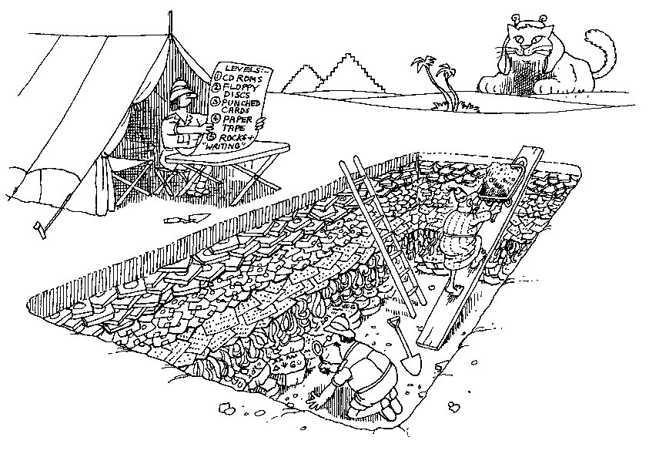
Software archeology defined
The recovery of essential details about an existing system sufficient to reason about, fix, adapt, modify, harvest, and use that system itself or its parts.

Slide 87
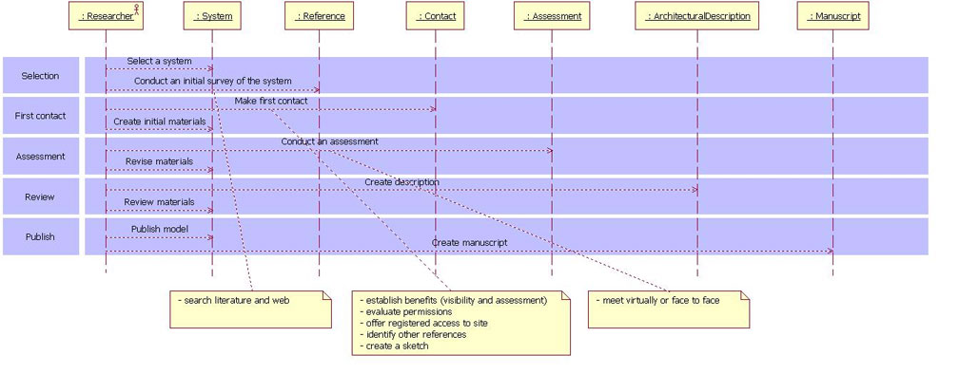
The process of archeology
Study source code
Reverse engineering
Probing and other instrumentation
Review existing documents
Interview tribal leaders

Slide 88
The process of archeology
Most design information lives in tribal memory
Typically there exists very high level architectural views and very low level design views, but little in between
Reconstructing deployment and implementation views is easy
Reconstructing the use case view is possible
Reconstructing the logical and process views is hard
Harvesting patterns is harder still

Slide 89

Preservation of classic software
No comprehensive and intentional activity has yet been undertaken to preserve the industry’s seminal software artifacts
There are a number of reasons to act now
  Many of the authors of such systems are still alive
  Many others may have the source code or design documents for these systems collecting dust in their offices or garages
  Time is our enemy
http://www.computerhistory.org

Slide 90
Goals
Preserving such artifacts for future generations is more than a valuable historical curiosity
  The understanding and codification of architectural patterns
  The evolution of software architecture and how they were products of their time
  A statement of prior art relevant to the issues of proving and disproving software patents
Preserving such artifacts provides raw materials for future generations of archeologists, historians, and developers who can learn from the past regarding
  What worked and what didn't
  What was brilliant and what was an utter failure

Slide 91
The big questions
What systems do we preserve?
What artifacts should we collect?
How do we make these artifacts available?
How can we create a sustainable program?

Slide 92

Handbook of software architecture
No architectural reference exists for software-intensive systems
Goals of the handbook
  Codify the architecture of a large collection of interesting software-intensive systems
  Study these architectural patterns in the context of the engineering forces that shaped them
  Satisfy my curiosity
http://www.booch.com/architecture

Slide 93
Systems under study
Artificial Intelligence
  Systems that simulate or augment human cognition, locomotion, or other organic processes
Commercial and Non-Profit
  Systems that are fundamental to the operation of a business enterprise or that provide some essential end customer value
Communications
  Systems that provide the infrastructure for transferring and managing data, for connecting users of that data, or for presenting data at the edge of an infrastructure
Content Authoring
  Systems that are used to create or edit textual or multimedia artifacts

Slide 94
Systems under study
Development
  Systems that are used to develop other systems
Devices
  Systems that interact with the physical world to provide some individual point service
Entertainment and Sports
  Systems that manage public events or that provide a large group entertainment experience
Financial
  Systems that provide the infrastructure for transferring and managing money and other securities

Slide 95
Systems under study
Games
  Systems that provide an entertainment experience for individuals or groups
Industrial
  Systems that control physical processes
Legal
  Systems that support the legal industry
Medical
  Systems that diagnose or heal or that contribute to medical research
Military
  Systems for consultation, communications, command, control, and intelligence (C4I) as well as offensive and defensive weapons

Slide 96
Systems under study
Operating Systems
  Systems that sit just above hardware to provide basic software services
Platforms
  Systems that sit just above operating systems to provide advanced services
Scientific
  Systems that are used for scientific research and applications
Transportation
  Systems that control ground, air, or water vehicles
Utilities
  Systems that interact with other software to provide some individual point service

Slide 97
Summary
Every interesting software-intensive system has an architecture
The most successful software architectures are intentional, manifest, and visible - and beautiful

Slide 98
Thank you!

